Slide 1


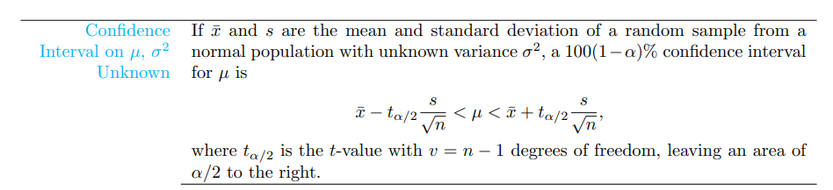
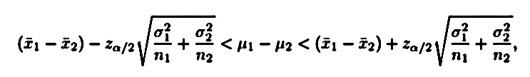

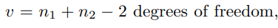
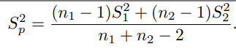
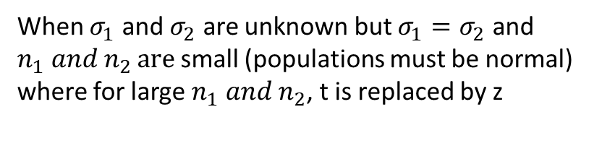
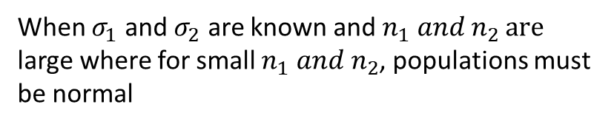
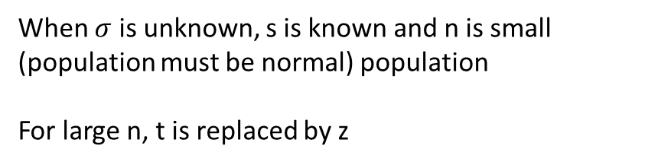

Summary of all estimation formulae
When $σ$ is known and n is large where for small n, population must be normal
When $σ$ is unknown, s is known and n is small (population must be normal) population
For large n, t is replaced by z
When $σ_{1}$ and $σ_{2}$ are known and $n_{1} and{ n}_{2 }are$ large where for small $n_{1} and n_{2}$, populations must be normal
When $σ_{1}$ and $σ_{2}$ are unknown but $σ_{1}=σ_{2}$ and $n_{1} and{ n}_{2 }are$ small (populations must be normal) where for large $n_{1} and n_{2}$, t is replaced by z

Slide 2

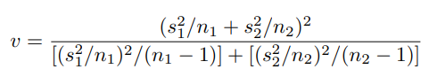
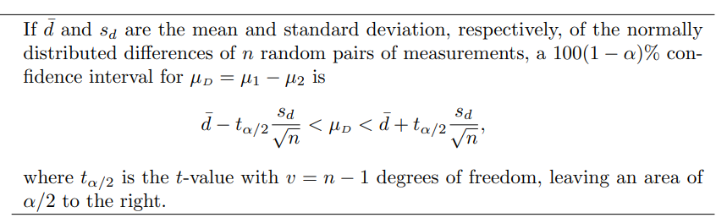

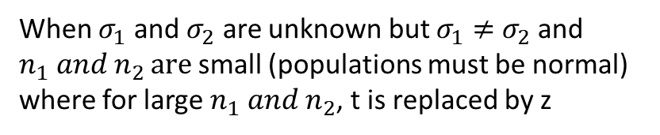

Summary of all estimation formulae
When $σ_{1}$ and $σ_{2}$ are unknown but $σ_{1}≠$ $σ_{2}$ and $n_{1} and{ n}_{2 }are$ small (populations must be normal) where for large $n_{1} and n_{2}$, t is replaced by z
Note: For only lower or upper intervals, $\frac{α}{2}$is replaced by $α$ in all formulae

